Slide 1
Chapter 14
Capital Investment Appraisal

Slide 2
Objectives
After studying this topic you should be able to:
Understand the importance of capital investment appraisal (CIA);
Develop a working knowledge of financial CIA techniques;
Appreciate the ‘time value’ of money in the CIA context; and
Be able to consider the strategic implications of CIA decisions.

Slide 3
Methods
Accounting rate of return
Payback Period
Discounted Payback period
Net Present value
Internal rate of return
Profitability Index

Slide 4
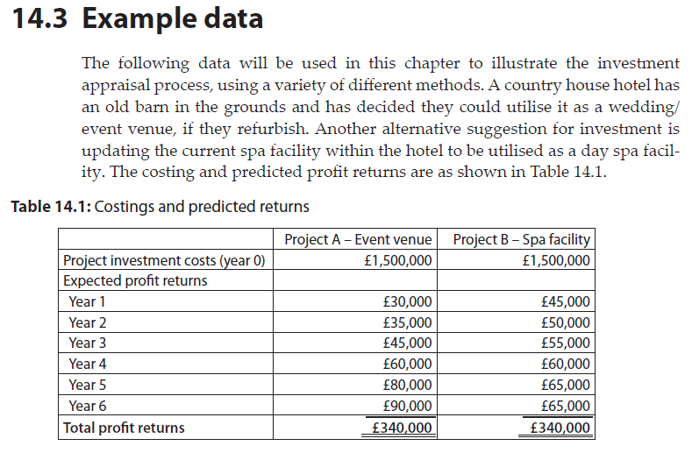
Example data

Slide 5
Accounting Rate of Return (ARR)
This approach calculates the average annual profit as a percentage of the average amount invested. It is the only CIA method that is based on profits; all other methods use cash flows (discussed later). It is calculated as follows:
Average Annual Profit * 100 = %ARR
Average Investment
An alternative formula is to use ‘Initial Investment’ instead of ‘Average Investment’.
Average Annual Profit * 100 = %ARR
Initial Investment

Slide 6
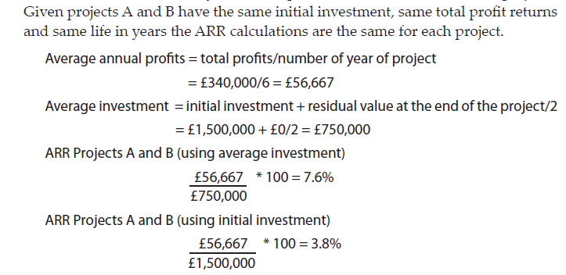
Accounting Rate of Return (ARR) - example

Slide 7
Payback period (PBP)
As the name suggests, this method considers how long it takes to get back in cash inflows what went out in the initial investment.

Slide 8
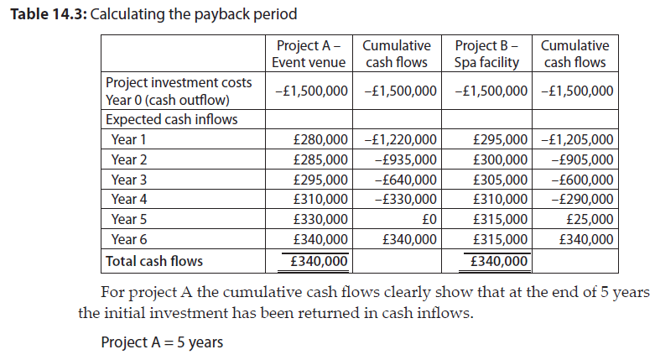
Payback period (PBP) – example (1)

Slide 9
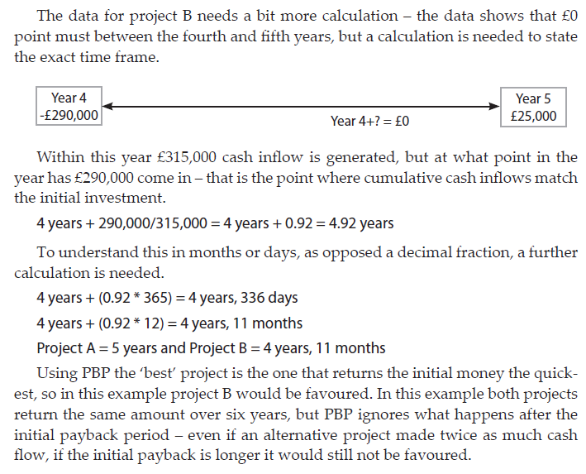
Payback period (PBP) – example (2)

Slide 10
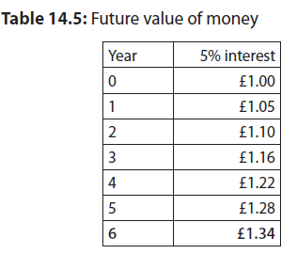
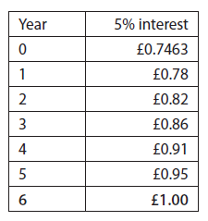
The time value of money
More sophisticated methods consider the time value of money – is £1 today worth the same value in 5 years time?

Slide 11
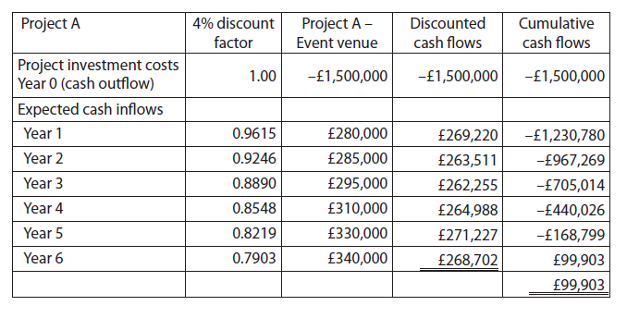
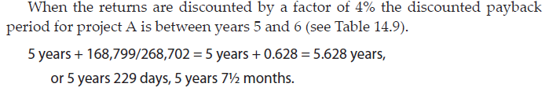
Discounted payback period
Calculated as for payback but the cash flows are discounted to reflect the time value of money.

Slide 12
Net present value (NPV)
The NPV approach allows for the time value of money, by using a set discount factor. Unlike the discounted payback period it also takes into account cash inflows over the full life of the project.
Given the discount factor the rule is if the NPV value is above £0 the project is acceptable, any project with a negative NPV should be rejected. If funds are not available to fund all projects then the projects should be prioritised in the order of the maximum NPV first.

Slide 13
Net present value (NPV)
Steps:
Identify discount factor to be used
Calculate discount factor, or use tables
Multiple annual cash flows by discount factors
Total the discounted cash flows
If positive accept project, if negative reject

Slide 14
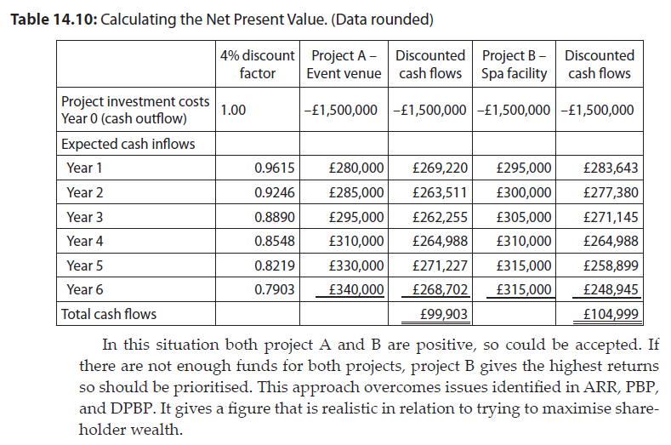
Net present value (NPV)
Example

Slide 15
Internal Rate of return (IRR)
IRR works in the opposite way be considering what discount rate (cost of capital) can be applied in order for the NPV to equal £0. It requires a positive and negative NPV to be calculated so the 0 point can be calculated.

Slide 16
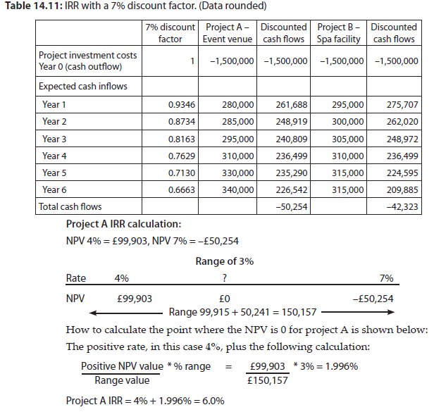
Internal Rate of return (IRR) - example

Slide 17
Profitability Index
When ranking projects another alternative is to calculate their Profitability Index (PI). This is done by dividing the discounted inflows by the investment.
Discounted Inflows
Initial Investment

Slide 18
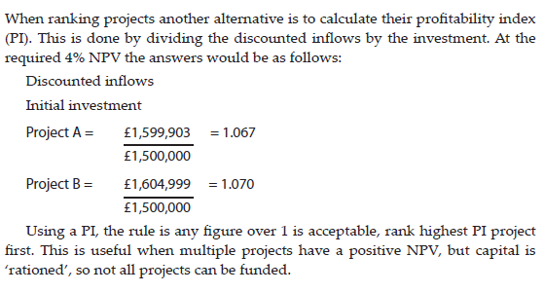
Profitability Index - example

Slide 19
Uncertainty in investment projects
Adjusting the basic cash flows.
Adjusting the rate required. A higher rate may be required from projects with higher levels of risk.
Use of three estimates – a high, medium and low estimated (best, expected and worse case scenarios). This gives the extreme potential results.
Applying probability factors. This is a more sophisticated version of the three estimates approach, where the likelihood of each outcome is weighted into the estimates.
Sensitivity analysis. This can involve looking at each aspect of the project (income and expenditure) and considering how sensitive each element is to change. For example; what if sales changed by 10%, or what if staff costs changed by 10%?

Slide 20
Integrated strategic approaches
Fit with strategic plan;
Chance of negative publicity;
Impact on current market position;
Environmental impact;
Level of risk;
Project feasibility studies;
Periodic review and cost comparison once projects are started; and
Post-completion audit of project, lessons learned for the future.

Slide 21
Summary
Accounting rate of return is the only method to be based on profits, all others use cash flows.
Payback period is a simple method, but still commonly used in organisations.
Discounted Cash Flow methods consider the time value of money.
Where IRR and NPV rank different projects first place the NPV should be followed.
A number of integrated strategic approaches exist that integrate financial considerations with aspects of risk and strategic imperatives.

